Slide 1

Voting Application
Welcome to Voting Application, a project aiming to revolutionize the way college students vote. We, a team of dedicated individuals, have come together to develop a secure and user-friendly platform to facilitate fair and transparent elections for college subjects.

Slide 2
Meet the Team
Rishav Kishor
Satyam Singh
Dr. Vipin Kumar
Team Leader, Back-End Developer
Team Member, Front-End Developer
Project Mentor,
Associate Professor

Slide 3

Voting Application
1
Secure Platform
2
User-Friendly Interface
Ensuring secure storage and transmission of voter data, safeguarding privacy and integrity.
Designing an intuitive and accessible platform, simplifying the voting process for all users.
3
Transparent Results
4
Open Source
Enabling real-time tracking of vote counts and displaying results in a clear and concise manner.
Promoting transparency and collaborative development by making the platform's code accessible to the community.

Slide 4
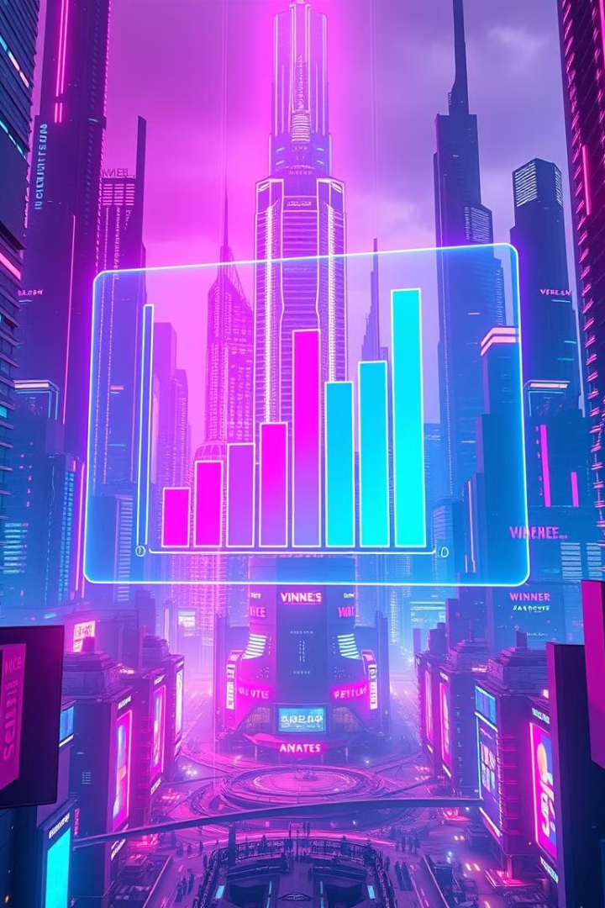
Project Objectives
1
Improve Election Participation
Increase voter turnout and engagement by offering a convenient and accessible voting platform.
2
Enhance Transparency
Increase trust in the election process by making it transparent and readily auditable.
3
Simplify Voting Process
Streamline the voting experience by eliminating complex procedures and paperwork.
4
Reduce Costs
Optimize the election process by leveraging technology to minimize traditional costs associated with physical voting.

Slide 5

Software Requirements
MongoDB
Express.js
A NoSQL database used for storing data, including voter information, candidate details, and vote results.
A framework for building the server-side of the application, handling requests and responses between the frontend and backend.
React.js
Node.js
A JavaScript library used to create a dynamic and responsive user interface for the platform.
A runtime environment enabling server-side JavaScript execution, facilitating server-side logic and backend functionalities.

Slide 6

Hardware Requirements
A system with at least 4 GB of RAM.
Processor: Intel i5 or higher
Disk Space: 20 GB free storage for project. development and testing.
Stable internet connection.

Slide 7

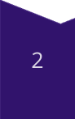
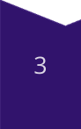


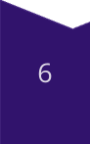
Project Methodology: Agile Development
Planning
Defining project goals, scope, and timelines.
Design
Creating wireframes and user interface mockups.
Development
Writing code and implementing features.
Testing
Ensuring the platform's functionality and security.
Deployment
Making the application accessible to users.
Maintenance
Monitoring performance and addressing issues.

Slide 8


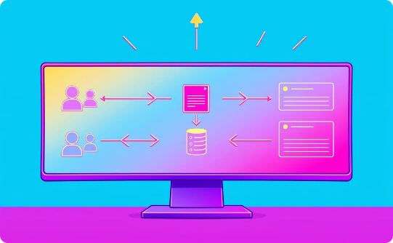
Data Flow Diagram
User Interaction
Data Validation
Data Storage
Users interact with the platform, submitting votes and accessing information.
The server verifies the authenticity and integrity of data submitted by users.
The database securely stores all vote information and other relevant data.

Slide 9





References
MongoDB Documentation
Express.js Documentation
https://www.mongodb.com/docs/manual/current/
https://expressjs.com/en/4x/api.html
React.js Documentation
Node.js Documentation
https://reactjs.org/docs/getting-started.html
https://nodejs.org/en/docs/

Slide 10
Thank You

